Slide 1

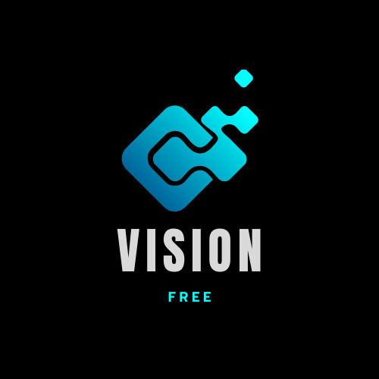

Mobile Base Sinhala Book
Reader for
Visually Impaired Individuals
TMP-23-198

Slide 2
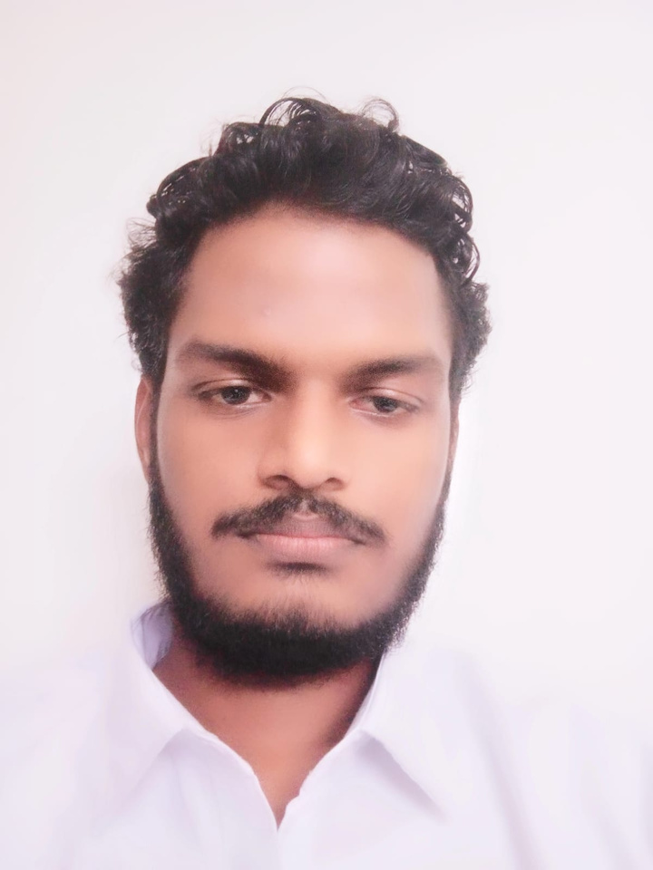
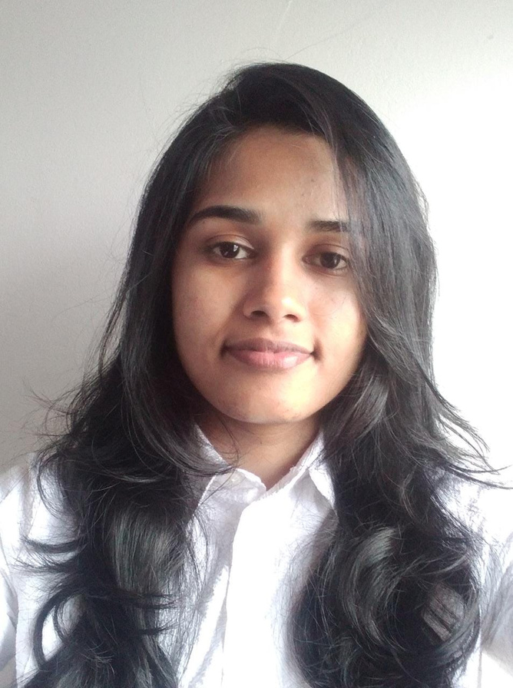
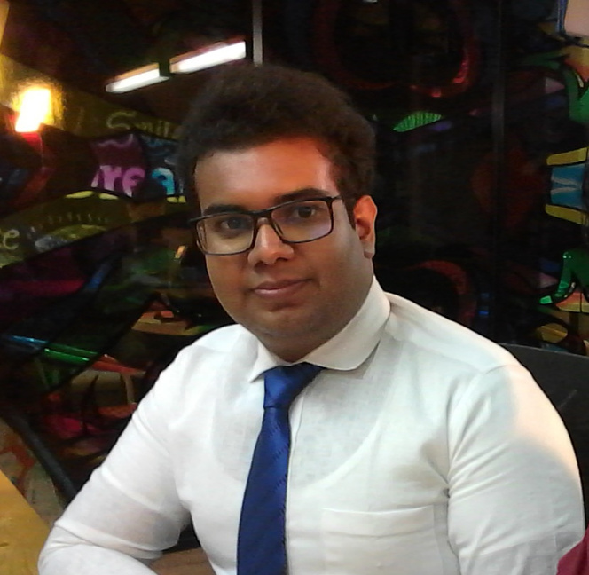
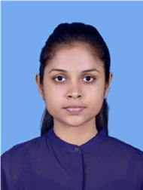
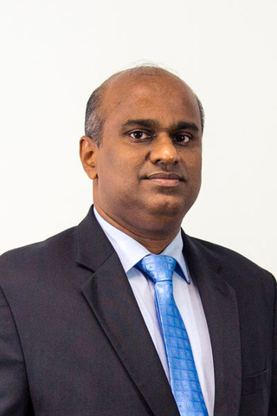
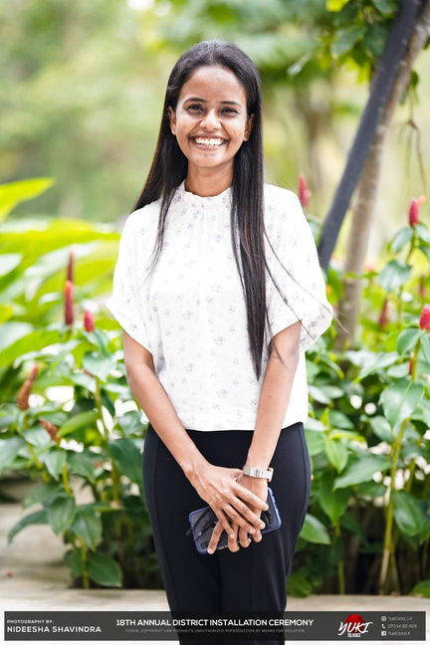
Our Team
Jayathunga T.M.
Semini
J.P.D.L
Godakanda P.G.S.
Bhagya H.D.M.
IT20146238
IT20241346
IT20129712
IT20254520
Prof. Koliya Pulasinghe
Ms. Poorna
Panduwawala
30 March, 2023

Slide 3


Introduction
According to the World Health Organization (WHO), there are 285 million physically impaired individuals worldwide, including 39 million blind people.
Communicating with blind persons requires a different approach than communicating with sighted individuals.
Verbal communication, tactile communication, and assistive technology are some of the ways to communicate with blind people.
Assistive technologies such as text-to-speech software, screen readers, and speech recognition software can also help blind people to communicate with others.
30 March, 2023

Slide 4

Commercialization
Identifying the Target Audience: In this case, the target audience would be visually Impaired Individuals who could benefit from the features of the Mobile Application.
Revenue Generation: Commercialization also involves generating revenue from the mobile application. This could involve charging for the application itself, offering premium features for a fee.
Promotions: The target audience should be reached through targeted campaigns on social media and other channels. Collaboration with organizations that work with visually impaired individuals, such as libraries or schools, can also be an effective way to reach the target audience.
30 March, 2023

Slide 5

Research Question
What are the user requirements and preferences for a mobile base Sinhala book reader for visually impaired individuals?
How can the accessibility of the book reader be enhanced for visually impaired individuals?
What are the existing technologies and tools available for creating a mobile base Sinhala book reader for visually impaired individuals?
How can the usability and user experience of the book reader be improved for visually impaired individuals?
How to Enhance The Overall Visually Impaired Individual's Satistification?
How to Address the Limited Availability of Sinhala-Language Resources for Visually Impaired Individuals?
30 March, 2023

Slide 6



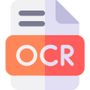


OBJECTIVES
SUB OBJECTIVE
MAIN OBJECTIVE
Voice Navigation & Object Identification
The primary purpose of creating a Sinhala book reader for visually impaired individuals is to enable them to access literature in their mother tongue.
This initiative aims to improve their literacy and promote their integration into society.
Optical Character Recognition (OCR)
Image conversion into Sinhala text
Text-to-Speech (TTS) Synthersizer
30 March, 2023

Slide 7
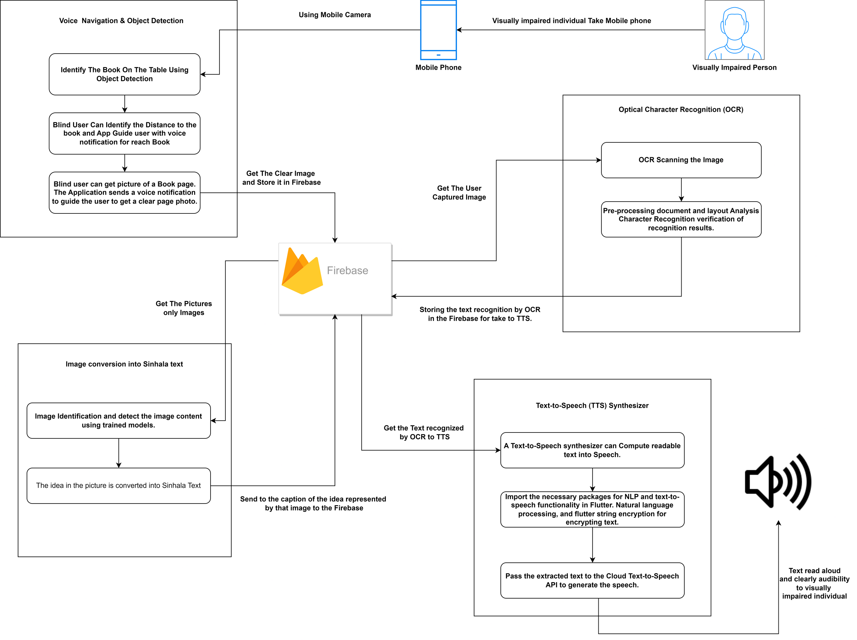
SYSTEM
DIAGRAM

Slide 8
Godakanda P.G.S
IT20129712
INFORMATION TECHNOLOGY
IT20129712 | Godakanda P.G.S. | TMP-23-198
30 March, 2023

Slide 9
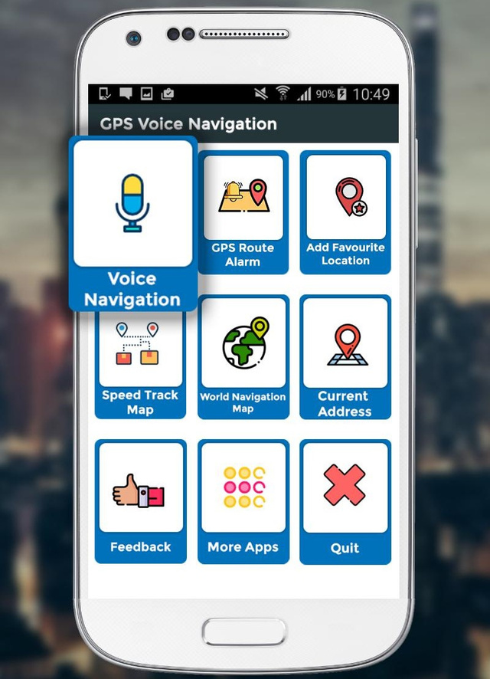
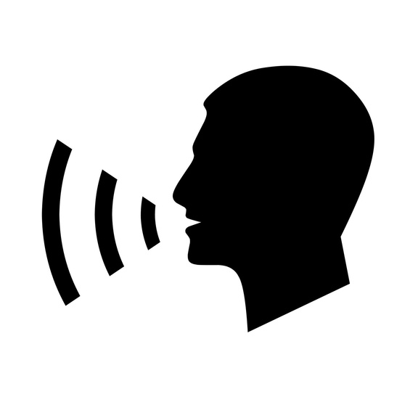
VOICE NAVIGATION
AND OBJECT DETECTION
IT20129712 | Godakanda P.G.S. | TMP-23-198
30 March, 2023

Slide 10
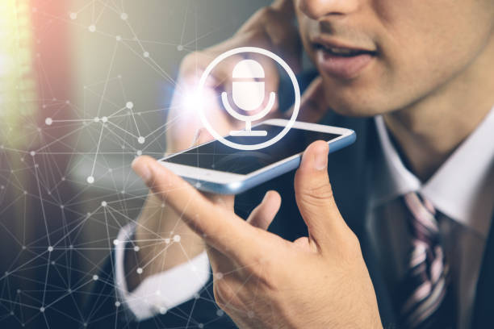
INTRODUCTION
Sinhala voice navigation is a technology that enables users to navigate an application using voice commands spoken in the Sinhala language, which is the primary language spoken in Sri Lanka. This technology is particularly useful for individuals who may have difficulty seeing as visually impaired persons, as it allows them to interact with the application in a more natural and intuitive way.
Voice navigation technology has become increasingly popular in recent years, as more and more people rely on their smartphones and other devices for daily tasks. Sinhala voice navigation technology is especially important for users in Sri Lanka, where the majority of the population speaks Sinhala as their first language.
Object detection is a computer vision technology that enables an app to identify and locate objects within an environment using the device's camera.
Using this technology, the user's potential benefit is the capability of exploring a new environment safely. This feature allows users to identify the objects around them and notify in the Sinhala language about what the object is and how much distance that object is.
IT20129712 | Godakanda P.G.S. | TMP-23-198
30 March, 2023

Slide 11
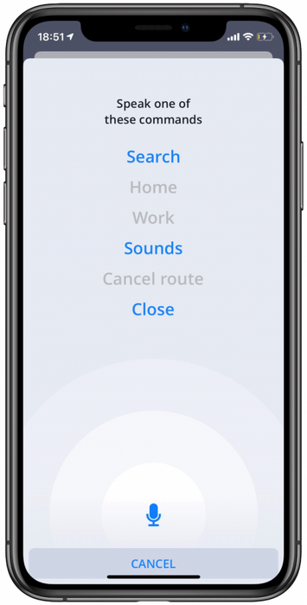
RESEARCH QUESTION
How effective is Sinhala voice navigation technology in improving the accessibility and usability of mobile applications for Sinhala-speaking users?
What are the key technical challenges in implementing Sinhala voice navigation in mobile applications, and how can these challenges be addressed?
How does the accuracy of Sinhala voice recognition technology compare to other voice recognition technologies, such as English or Mandarin?
What are the cultural and linguistic considerations that need to be taken into account when designing Sinhala voice navigation technology for mobile applications?
How can Sinhala voice navigation be integrated with other accessibility features, such as screen readers or haptic feedback, to create a more inclusive user experience?
What are the privacy and security implications of using voice commands to navigate mobile applications, and how can these concerns be addressed?
How can Sinhala voice navigation technology be adapted to support users with different levels of language proficiency or dialects?
IT20129712 | Godakanda P.G.S. | TMP-23-198
30 March, 2023

Slide 12
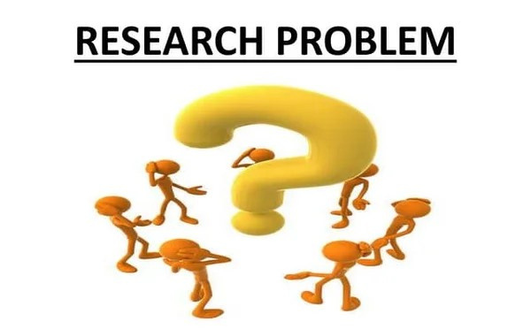
RESEARCH PROBLEM
The primary problem that this research project aims to address is the lack of comprehensive technology that can aid visually impaired people in their daily lives.
Visually impaired people face challenges in navigating an app, object detection, and avoidance, which limits their mobility and independence.
IT20129712 | Godakanda P.G.S. | TMP-23-198
30 March, 2023

Slide 13


RESEARCH GAP
References | Opportunities for implementing voice navigation technology for Sinhala-speaking users | Identify the voice of the user and identify the command clearly | Clear Sinhala Voice commands and navigations | Real time object detection and distance calculation, with guidance to avoid dangerous objects.
Research A
Research B
Research C
Proposed System
IT20129712 | Godakanda P.G.S. | TMP-23-198
30 March, 2023

Slide 14

OBJECTIVES
The primary problem that this research project aims to address is the lack of comprehensive technology that can aid visually impaired people in their daily lives.
Visually impaired people face challenges in navigating an app, object detection, and avoidance, which limits their mobility and independence.
IT20129712 | Godakanda P.G.S. | TMP-23-198
30 March, 2023

Slide 15
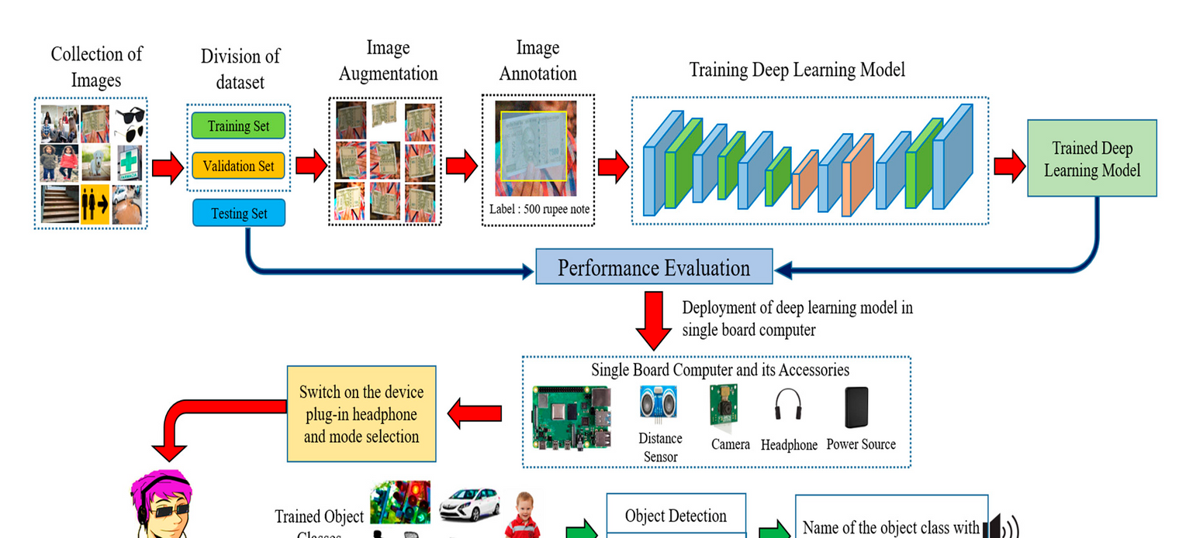
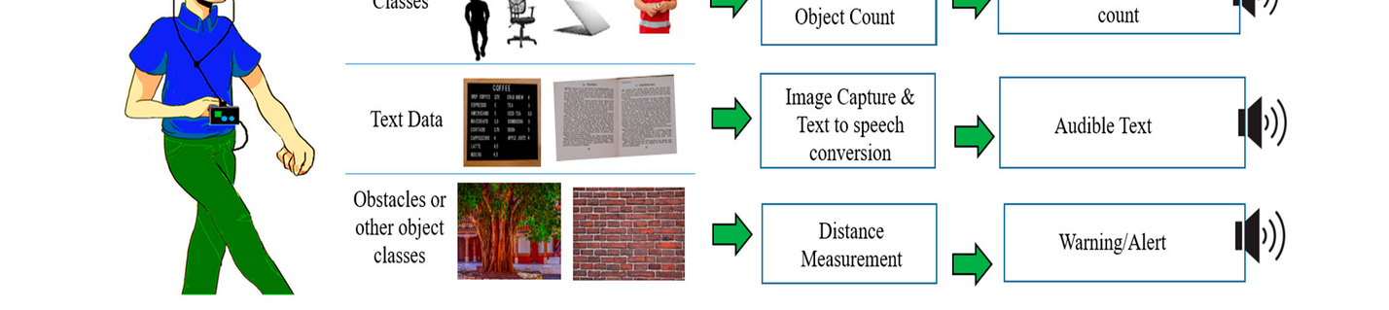
METHODOLOGY SYSTEM DIAGRAM
IT20129712 | Godakanda P.G.S. | TMP-23-198
30 March, 2023

Slide 16


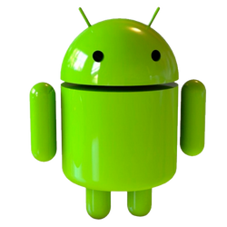



TECHNOLOGIES
Android
Flutter Framework
Firebase Database
Google's Natural Language API
Google Speech Recognition
Microsoft's Cognitive Services
Amazon Polly
TensorFlow
Natural Language Processing
IT20129712 | Godakanda P.G.S. | TMP-23-198
30 March, 2023

Slide 17
TECHNIQUES
1: System Design and Development
The first step of the research project will be to design and develop the system. The system will consist of a mobile app that will enable visually impaired people to navigate using voice commands. The app will also have an object detection and avoidance system that will instruct the user to avoid objects through voice commands.
2: Machine Learning Integration
The object detection and avoidance system will use machine learning to enhance its accuracy and efficiency. The system will be trained on a dataset of objects to detect and avoid. The machine learning algorithm will be integrated with the system to enable real-time object detection and avoidance.
3: System Testing and Validation
The developed system will be tested and validated to ensure its accuracy, efficiency, and effectiveness in aiding visually impaired people. The testing will be done using a sample of visually impaired people who will use the system and provide feedback on its performance. The system will be refined based on the feedback received to improve its performance
IT20129712 | Godakanda P.G.S. | TMP-23-198
30 March, 2023

Slide 18

FUNCTIONAL & NON-FUNCTIONAL REQUIREMENT
Functional
Non-Functional
Hardware: A computer with sufficient processing power, a smartphone or tablet, and a camera
Software: Programming languages (Python, Java, etc.), machine learning libraries (TensorFlow, PyTorch, etc.), app development frameworks (React Native, etc.)
Data: A dataset of images for object detection and distance calculation, as well as a dataset of voice commands and feedback responses
Performance: Responsive and seamless voice conversion and navigation.
Accessibility: The application should be accessible to visually impaired individuals and conform to accessibility guidelines.
Reliability: The application should be reliable and provide consistent voice conversion and feedback.
.
Security: The application should be secure to protect user information and reading history.
IT20129712 | Godakanda P.G.S. | TMP-23-198
30 March, 2023

Slide 19
SOFTWARE & PERSONAL REQUIREMENTS
Software Requirement
Mobile Operating System: The application should be compatible with Android operating systems.
Google's Natural Language API
Google Speech Recognition
Microsoft's Cognitive Services
Personal Requirements
Sinhala Language Support: The application should support the Sinhala language and have accurate voice commands and feedback.
IT20129712 | Godakanda P.G.S. | TMP-23-198
30 March, 2023

Slide 20
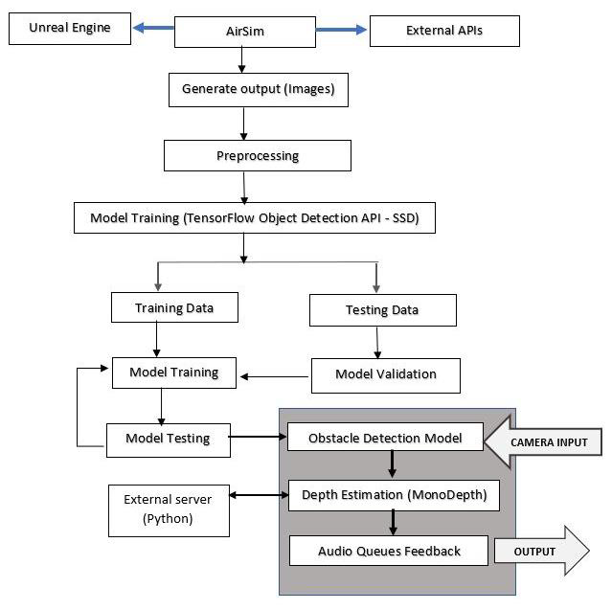
OVERALL IMPLEMENTATION PROCESS
IT20129712 | Godakanda P.G.S. | TMP-23-198
30 March, 2023

Slide 21
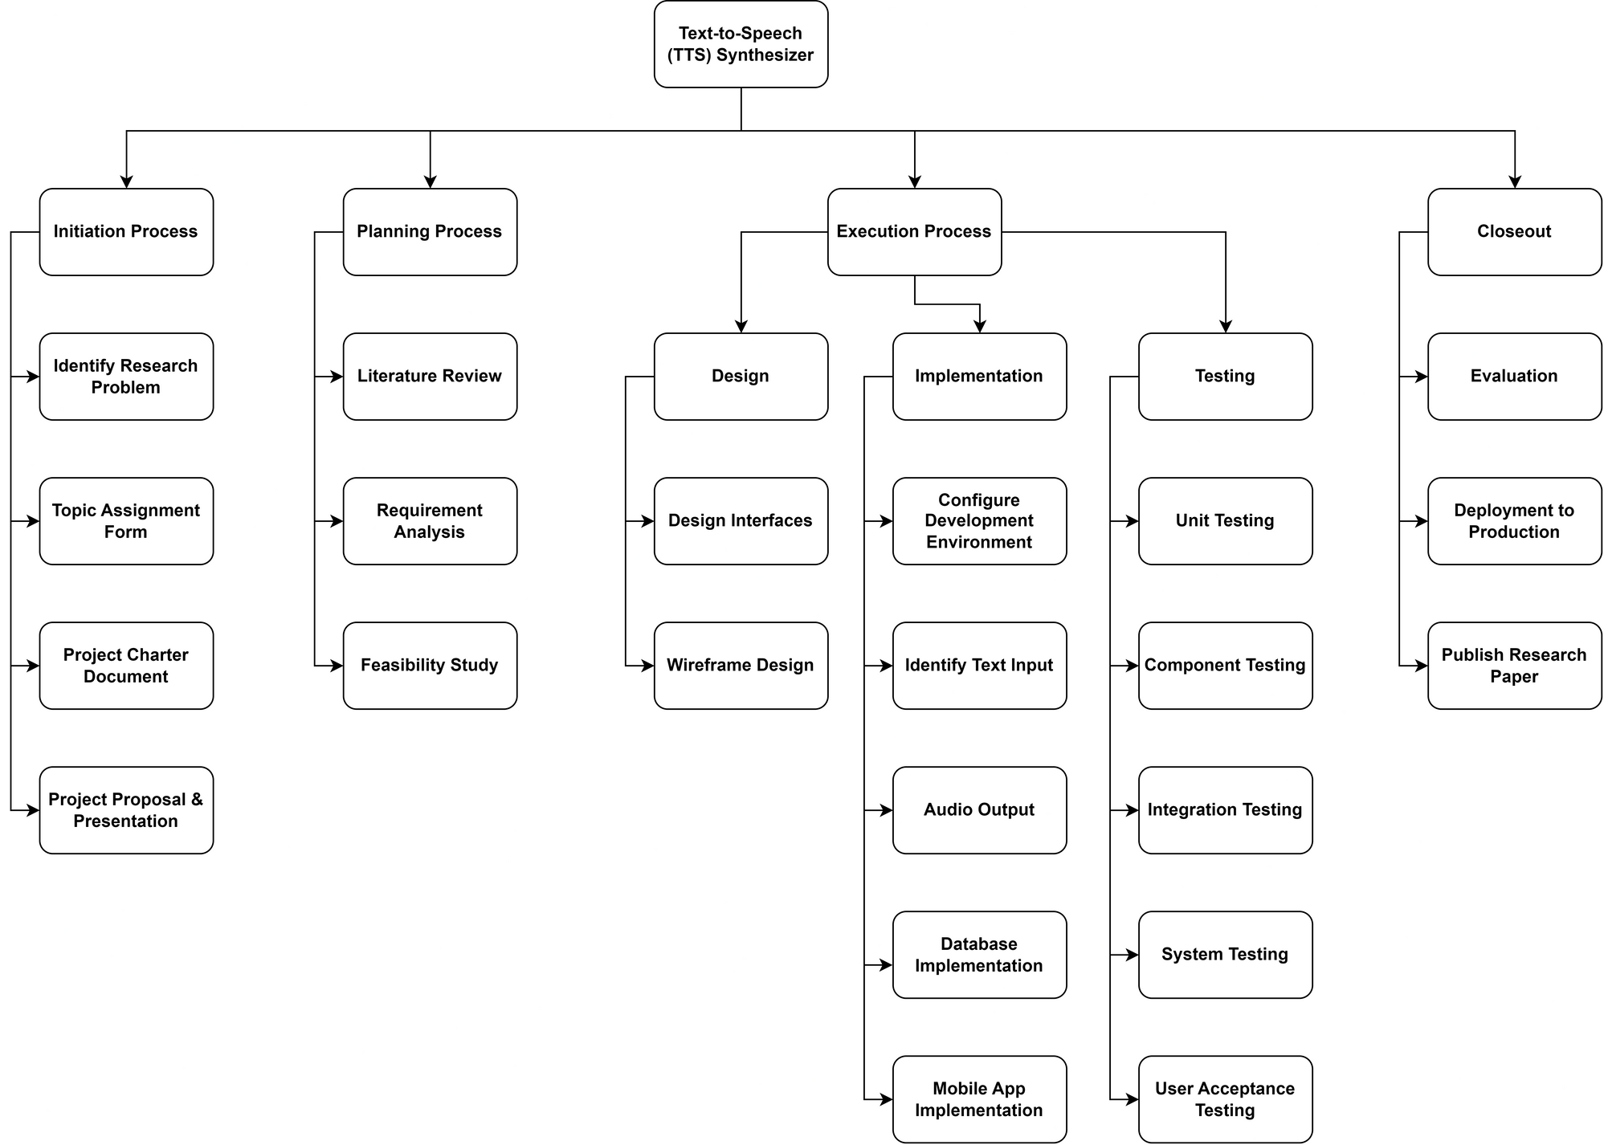
WORK BREAKDOWN STRUCTURE
Voice navigation and Object detection
IT20129712 | Godakanda P.G.S. | TMP-23-198
30 March, 2023

Slide 22
REFERRENCES
[1] “Vision Impairment and Blindness.” Accessed November 1, 2019. https://www.who.int/news-room/fact-sheets/detail/blindness-and-visual-impairment.
[2] Peng, En, Patrick Peursum, Ling Li, and Svetha Venkatesh. “A Smartphone-Based Obstacle Sensor for the Visually Impaired.” In Ubiquitous Intelligence and Computing, edited by Zhiwen Yu, Ramiro Liscano, Guanling Chen, Daqing Zhang, and Xingshe Zhou, 6406:590–604. Berlin, Heidelberg: Springer Berlin Heidelberg, 2010. https://doi.org/10.1007/978-3-642-16355-5_45.
[3] Caldini, Alessandro, Marco Fanfani, and Carlo Colombo. “Smartphone-Based Obstacle Detection for the Visually Impaired.” In Image Analysis and Processing — ICIAP 2015, edited by Vittorio Murino and Enrico Puppo, 9279:480–88. Cham: Springer International Publishing, 2015. https://doi.org/10.1007/978-3-319-23231-7_43.
[4] Mocanu, Bogdan, Andrei Bursuc, Titus Zaharia, and tapu. “A Smartphone-Based Obstacle Detection and Classification System for Assisting Visually Impaired People.” In 2013 IEEE International Conference on Computer Vision Workshops, 444–51. Sydney, Australia: IEEE, 2013. https://doi.org/10.1109/ICCVW.2013.65.
[5] Lin, Bor-Shing & Lee, Cheng-Che & Chiang, Pei-Ying. (2017). Simple Smartphone-Based Guiding System for Visually Impaired People. Sensors. 17. 1371. 10.3390/s17061371.
IT20129712 | Godakanda P.G.S. | TMP-23-198
30 March, 2023

Slide 23
REFERRENCES
[6] Velázquez, R., Pissaloux, E., Rodrigo, P., Carrasco, M., Giannoccaro, N., Lay-Ekuakille, A., 2018. An Outdoor Navigation System for Blind Pedestrians Using GPS and Tactile-Foot Feedback. Applied Sciences 8, 578. https://doi.org/10.3390/app8040578
[7] Liu, Yongqing & Chen, Qi. (2018). Research on Integration of Indoor and Outdoor Positioning in Professional Athletic Training. Proceedings. 2. 295. 10.3390/proceedings2060295
.
[8] Kumar Yelamarthi, Daniel Haas, Daniel Nielsen, and Shawn Mothersell. 2010. RFID and GPS integrated navigation system for the visually impaired. In 2010 53rd IEEE International Midwest Symposium on Circuits and Systems. IEEE Press, Piscataway, NJ, USA, 1149–1152. DOI: http://dx.doi.org/10.1109/MWSCAS.2010.5548863
[9] “Accuracy of GPS Data - OpenStreetMap Wiki.” Accessed November 1, 2019. https://wiki.openstreetmap.org/wiki/Accuracy_of_GPS_data.
[10] “Electronic Travel Aids for the Blind.” Accessed November 1, 2019. https://www.tsbvi.edu/orientation-and-mobility-items/1974-electronic-travel-aids-for-the-blind.
IT20129712 | Godakanda P.G.S. | TMP-23-198
30 March, 2023

Slide 24
REFERRENCES
[11] A. Amedi, et. al “Shape conveyed by visual-to-auditory sensory substitution activates the lateral occipital complex,” Nature Neuroscience, vol.10, no. 6, pp. 687-689, June 2007.
[12] T. Schwarze, M. Lauer, M. Schwaab, M. Romanovas, S. B¨ohm, and T.J¨urgensohn, “A camera-based mobility aid for visually impaired people”,KI-K¨unstliche Intelligenz, pp. 18, 2015.
[13] P. Bach-Y-Rita and S. W. Kercel “Sensory substitution and the human machine interface, “ Trends Cogn Sci., vol. 7, no. 12, pp.541-546, Dec.2003.
[14] Shachar, Maidenbaum, Hanassy Shlomi, Abboud Sami, Buchs Galit, Chebat Daniel-Robert, Levy-Tzedek Shelly, and Amedi Amir. “The &ldquo;EyeCane&rdquo;, a New Electronic Travel Aid for the Blind: Technology, Behavior &amp; Swift Learning.” Restorative Neurology and Neuroscience, no. 6 (2014): 813–824. https://doi.org/10.3233/RNN-130351.
[15] Dakopoulos, D., and N.G. Bourbakis. “Wearable Obstacle Avoidance Electronic Travel Aids for Blind: A Survey.” IEEE Transactions on Systems, Man, and Cybernetics, Part C (Applications and Reviews) 40, no. 1 (January 2010): 25–35. https://doi.org/10.1109/TSMCC.2009.2021255.
IT20129712 | Godakanda P.G.S. | TMP-23-198
30 March, 2023

Slide 25
Semini J.P.D.L.
IT20241346
INFORMATION TECHNOLOGY
IT20241346 | Semini J.P.D.L. | TMP-23-198
30 March, 2023

Slide 26
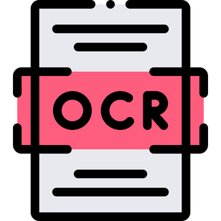
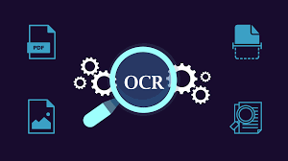
OPTICAL CHARACTER RECOGNITION (OCR)
IT20241346 | Semini J.P.D.L. | TMP-23-198
30 March, 2023

Slide 27
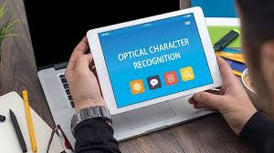
INTRODUCTION
Optical character recognition is the process of classification of optical patterns contained in a digital image. This turns images of typed, handwritten, or printed text into machine-encoded text that might be electronic or mechanical.
This allows users to scan and recognize text from images or documents using the camera of their smartphone. With the help of OCR technology, the app can convert recognized text into spoken words, allowing visually impaired individuals to access and understand the content.
We understand the importance of inclusive technology, and we are committed to providing visually impaired individuals with the tools they need to access information and enhance their quality of life. With the OCR part of our app, users can read books.
Most existing OCR programs are designed for English and industrial use, so this application is mainly for the Sinhala language.
IT20241346 | Semini J.P.D.L. | TMP-23-198
30 March, 2023

Slide 28

RESEARCH QUESTION
What are the key features and functionalities that blind users look for in an OCR mobile app, and how can these be optimized for a better user experience?
What are the current challenges and limitations in OCR technology for mobile apps, and how can they be overcome to improve the accuracy and speed of text recognition?
What are the best ways to train and educate blind people on how to use OCR mobile apps effectively, and what are some common barriers to adoption and usage?
How can OCR technology be combined with other assistive technologies, such as voice assistants?
The challenge of achieving high accuracy and reliability in text recognition, particularly when dealing with a wide range of fonts, styles, and languages
IT20241346 | Semini J.P.D.L. | TMP-23-198
30 March, 2023

Slide 29

RESEARCH PROBLEM
Most visually impaired people in Sri Lanka doesn't have a proper platform to capture the texts they need and read it.
Identify the limitations of visually impaired people while using a smart phone and thier knowledge about the technology.
IT20241346 | Semini J.P.D.L. | TMP-23-198
30 March, 2023

Slide 30
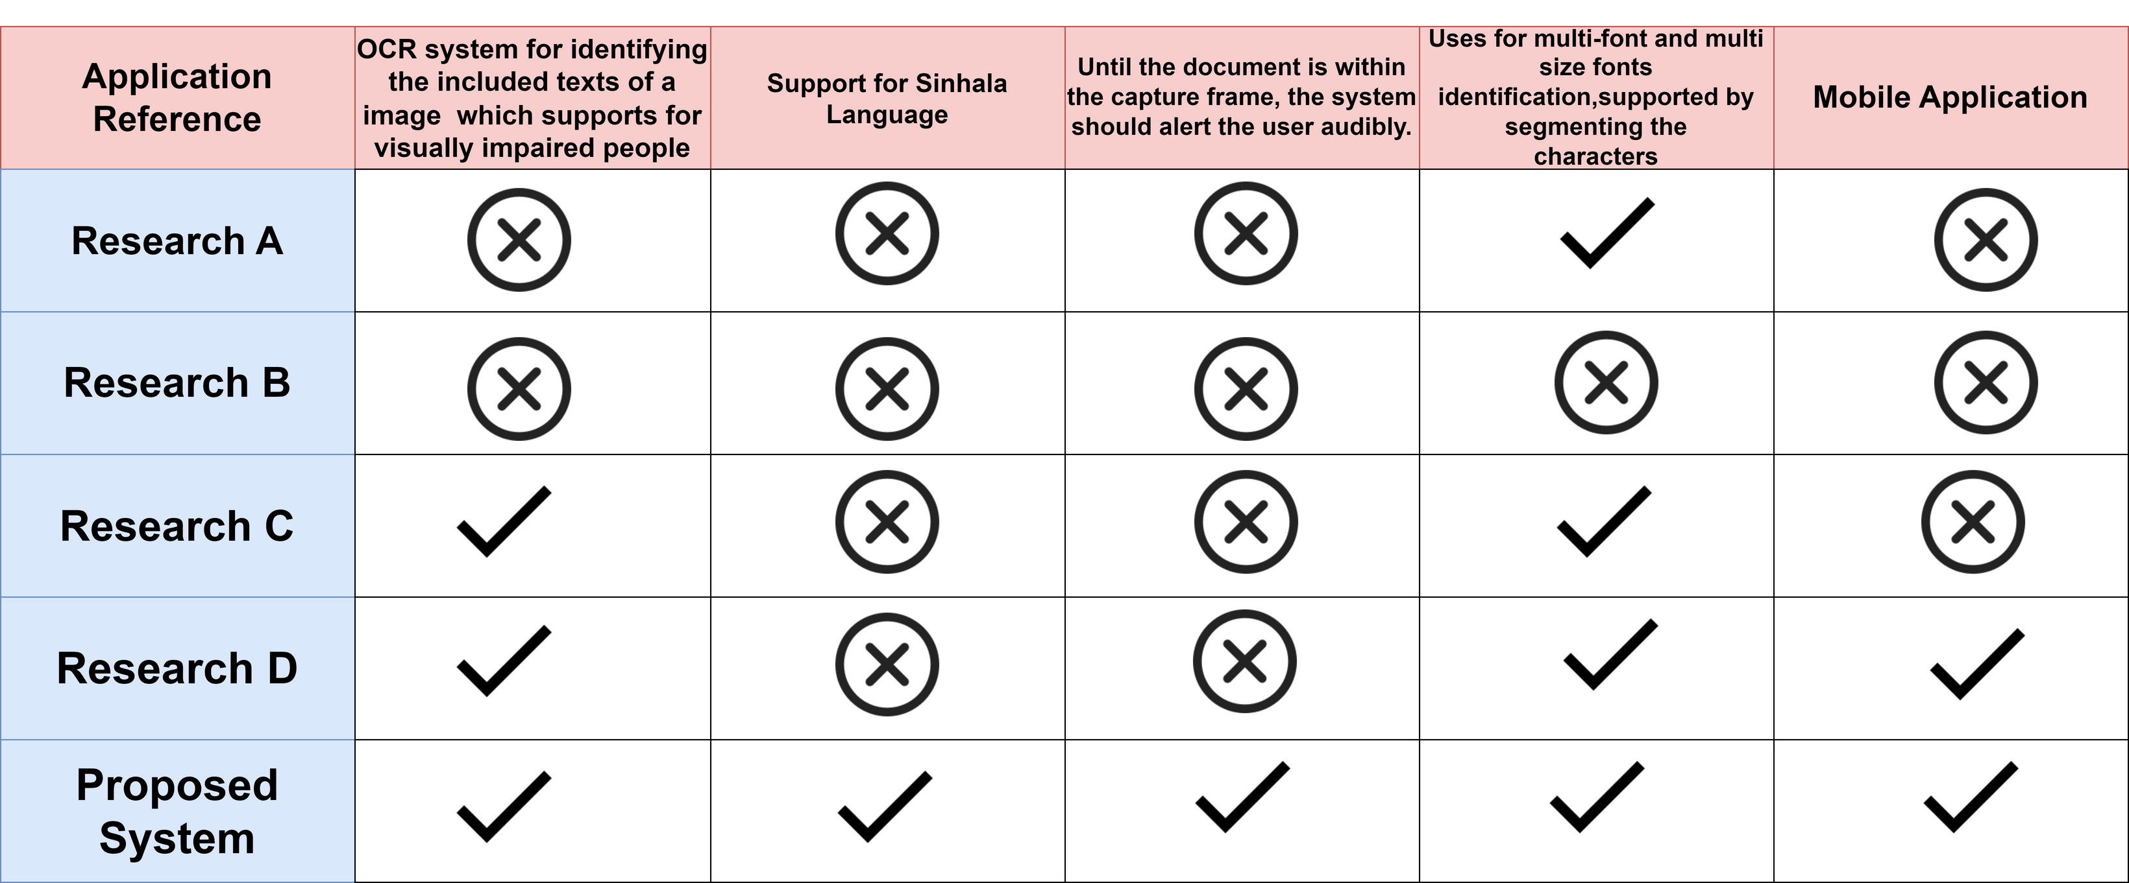
RESEARCH GAP
IT20241346 | Semini J.P.D.L. | TMP-23-198
30 March, 2023

Slide 31
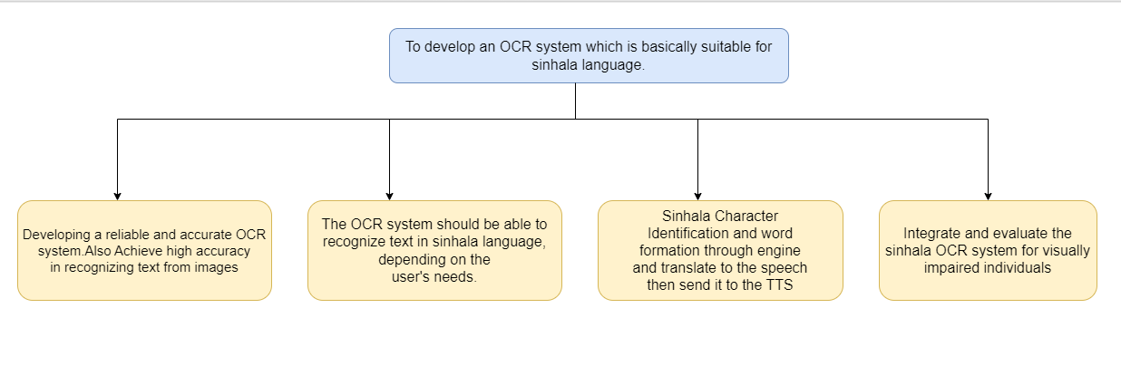
OBJECTIVES
IT20241346 | Semini J.P.D.L. | TMP-23-198
30 March, 2023

Slide 32
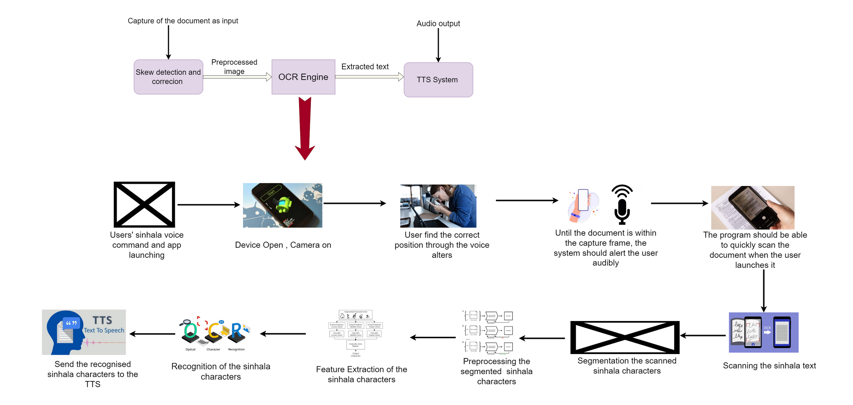
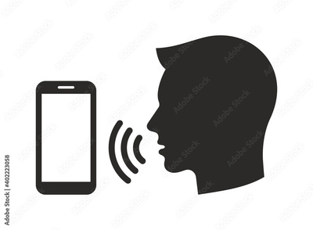
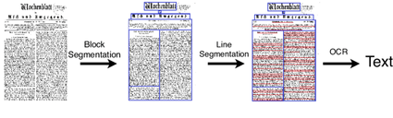
METHODOLOGY SYSTEM DIAGRAM
IT20241346 | Semini J.P.D.L. | TMP-23-198
30 March, 2023

Slide 33


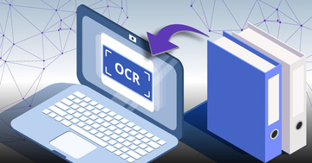


TECHNOLOGIES
Android
Flutter Framework
Firebase Database
OCR Engine
Tesseract OCR
Google Cloud Vision OCR
Google API
Natural Language Processing
IT20241346 | Semini J.P.D.L. | TMP-23-198
30 March, 2023

Slide 34

TECHNIQUES
OCR engine: The OCR engine is the core component of the app, which is responsible for converting the scanned image into text. The OCR engine should be able to recognize different fonts and text sizes accurately
Accessibility: The app should be designed to be accessible for users with different levels of visual impairment.
Testing: Testing is a critical component of app development, and it is especially important when building an app for blind users. The app should be tested with blind users to ensure that it is accessible and easy to use.
Techniques for continuous integration and deployment can make it possible to update the app more efficiently and frequently
Localization techniques can ensure that the app is properly
adapted to the Sinhala language and culture.
The device's storage should be used to store the image that
was captured.
IT20241346 | Semini J.P.D.L. | TMP-23-198
30 March, 2023

Slide 35
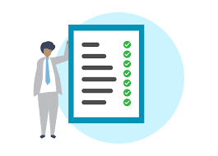
REQUIREMENTS
Functional Requirements:-
Accurate character recognition: The OCR software must be able to accurately recognize characters from scanned images, even if they are of poor quality or resolution.
Language support: The OCR software must be able to recognize characters in Sinhala languages .
User customization: The OCR software must allow users to customize the font size and background of the text for each of reading.
Accessibility features: The OCR software must comply with accessibility guidelines and have features such as when app is not running the program should also be able to start with a voice command
Non -Functional Requirements:-
Reliability
Performance
Availability
Security
System should respond in real-time
IT20241346 | Semini J.P.D.L. | TMP-23-198
30 March, 2023

Slide 36

SOFTWARE & PERSONAL REQUIREMENTS
Software Requirement
Mobile Operating System: The application should be compatible with Android operating systems.
OCR Engine: The application should use a reliable and high-quality OCR engine like Tesseract OCR
Personal Requirements
Sinhala Language Support: The application should support the Sinhala language and OCR should identify the sinhala characters.
IT20241346 | Semini J.P.D.L. | TMP-23-198
30 March, 2023

Slide 37
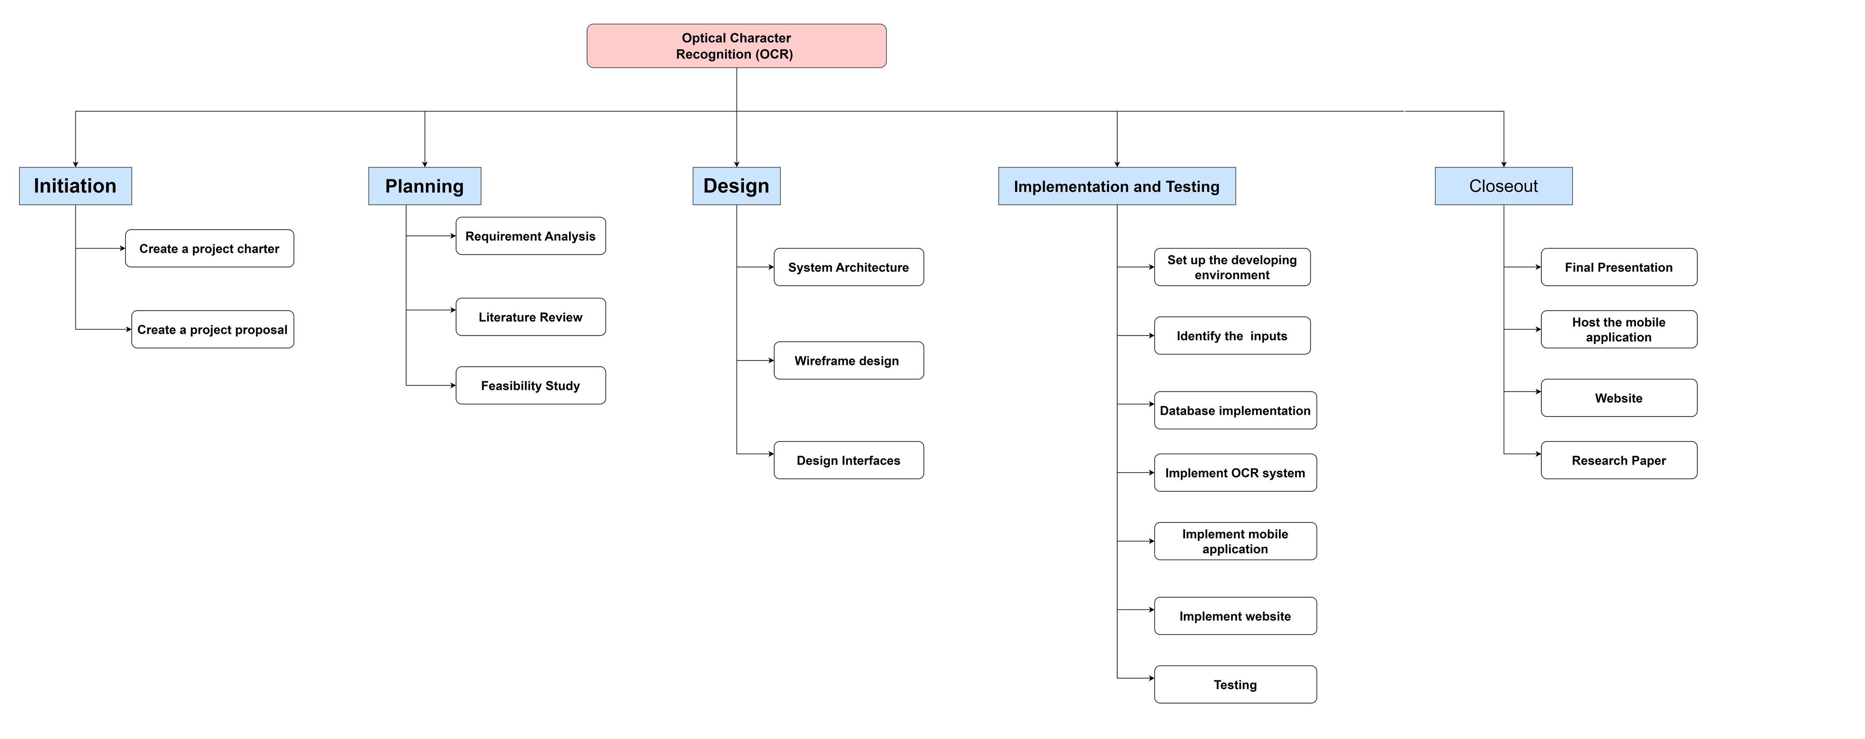
WORK BREAKDOWN CHART
IT20241346 | Semini J.P.D.L. | TMP-23-198
30 March, 2023

Slide 38
REFERENCES
[1] A. Subramanian and B. Kubendran, “Optical Character Recognition of Printed Tamil Characters,” 2000..
[2]R. Smith. “An overview of the Tesseract OCR Engine.” Proc 9th Int. Conf. on Document Analysis and Recognition, IEEE, Curitiba, Brazil, Sep 2007, pp629-633.
[3]Muhammad Farid Zamir, Khan Bahadar Khan,Shafquat Ahmmad Khan and Eid Rehman, "Smart Reader for Visually Impaired People Based on Optical Character Recognition",Department of Telecommunication Engineering, UCET, The Islamia University of Bahawalpur, Bahawalpur 63100, Pakistan,
[4]Roberto Neto and Nuno Fonseca,"Camera Reading For Blind People ", Polytechnic Institute of Leiria, Leiria 2411-901 Leiria, PORTUGAL
[5] Veena Bansal and R.M.K. Sinha, “A Complete OCR for Printed Hindi Text in Devnagari Script”, Sixth International Conference on Document Analysis and Recognition, IEEE Publication, Seatle USA, 2001. Page(s): 800-804
[6]Velmurugan, D., et al.: A Smart reader for visually impaired people using Raspberry pi.
IJESC. https://doi.org/10.4010/2016.699. ISSN 2321 3361 ©2016
IT20241346 | Semini J.P.D.L. | TMP-23-198
30 March, 2023

Slide 39
REFERENCES
[7]Raghuraj Singh1 , C. S. Yadav2 , Prabhat Verma3 , Vibhash Yadav4,"Optical Character Recognition (OCR) for Printed Devnagari Script Using Artificial Neural Network" ,January-June 2010, pp. 91-95
[8] S. Mori et. al, “Historical Review of OCR Research and Development”, Proceeding IEEE, 80, no 7, pp. 1029-1058, July 1992.
[9] World Health Organization, “Blindness and vision impairment,” 2021. [Online]. Available: https://www.who.int/en/news-room/fact-sheets/detail/blindness-and?visual-impairment. [Accessed: 05-Mar-2021]..
[10] S.V. Rice, G. Nagy, T.A. Nartker, Optical Character Recognition: An Illustrated Guide to the Frontier, Kluwer Academic Publishers, USA 1999, pp. 57-60.
[11] Zhou, S.Z., Open Source OCR Framework Using Mobile Devices, Multimedia on Mobile Devices 2008. Edited by Creutzburg, Reiner; Takala, Jarmo H. Proceedings of the SPIE, Volume 6821, article id. 682104, 6 pp. (2008)
IT20241346 | Semini J.P.D.L. | TMP-23-198
30 March, 2023

Slide 40
Bhagya H.D.M.
IT20254520
INFORMATION TECHNOLOGY
IT20254520 | Bhagya H.D.M. | TMP-23-198
30 March, 2023

Slide 41
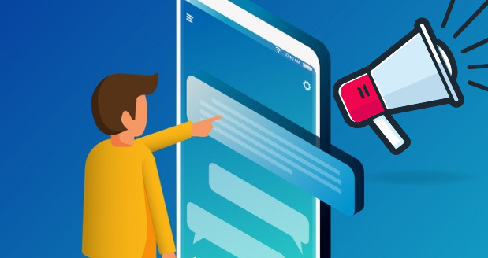
Image conversion into Sinhala text
IT20254520 | Bhagya H.D.M. | TMP-23-198
30 March, 2023

Slide 42
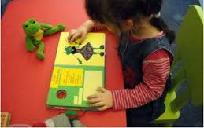
INTRODUCTION
Image detection and conversion to speech for blind users is an area of research in computer vision and assistive technology.
The goal is to enable visually impaired individuals to have greater access to visual information in their environment.
Traditional methods of using Braille or tactile cues can be limited in scope and time-consuming to learn. With the advent of mobile technology and machine learning, image detection apps offer an innovative and accessible solution to this problem.
IT20254520 | Bhagya H.D.M. | TMP-23-198
30 March, 2023

Slide 43

RESEARCH QUESTION
How effective is a mobile-based Sinhala book reader with an image detection function in improving reading accessibility for visually impaired individuals in Sri Lanka, and what factors contribute to its effectiveness?
What are the challenges and opportunities in designing and developing a mobile-based Sinhala book reader with an image detection function that meets the needs of visually impaired individuals in Sri Lanka?
How does the use of a mobile-based Sinhala book reader with an function affect the image experience and satisfaction of visually impaired individuals in Sri Lanka, and how does it compare to other image detection aids and tools currently available?
IT20254520 | Bhagya H.D.M. | TMP-23-198
30 March, 2023

Slide 44

RESEARCH PROBLEM
What types of visual information are most important for blind or visually impaired children to access in images, and how can we present this information in a way that is meaningful and engaging for them?
IT20254520 | Bhagya H.D.M. | TMP-23-198
30 March, 2023

Slide 45
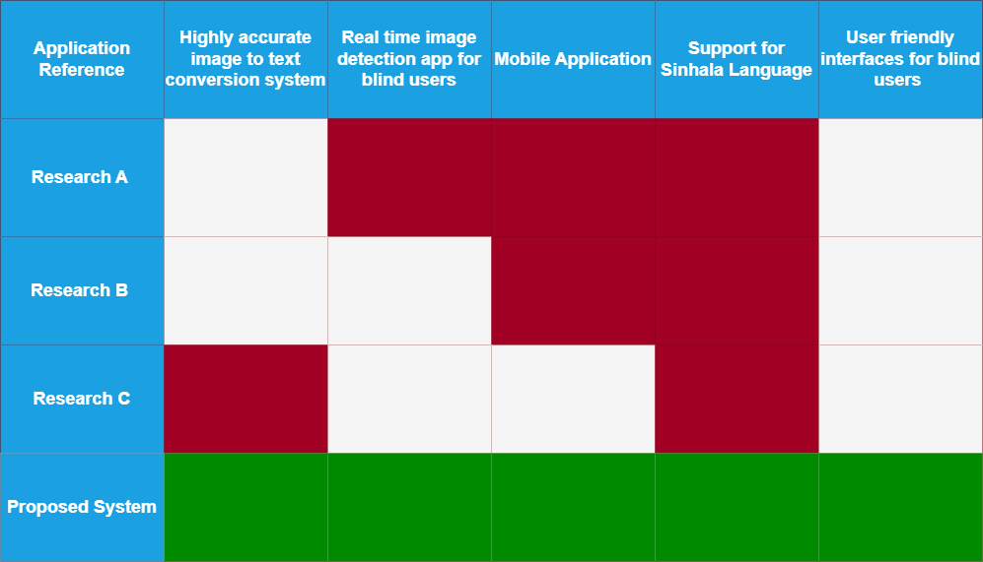
RESEARCH GAP
IT20254520 | Bhagya H.D.M. | TMP-23-198
30 March, 2023

Slide 46
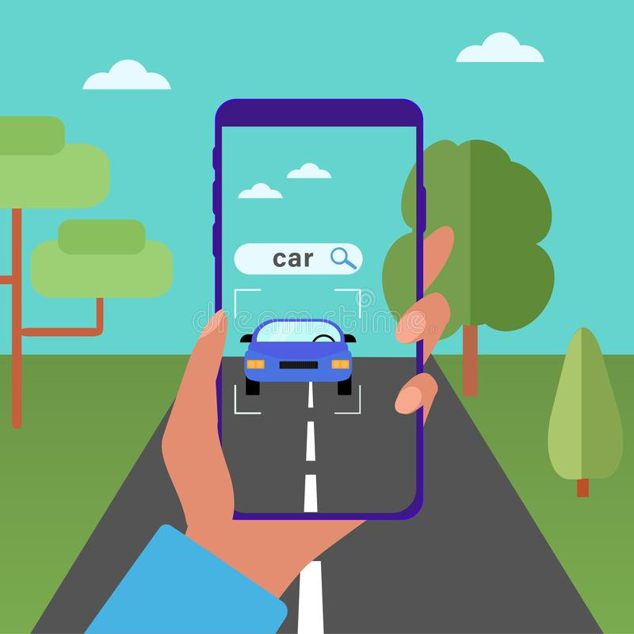
OBJECTIVES
Enhancing accessibility
Improving quality of life
Increased independence
Enhanced entertainment
Enhanced education
IT20254520 | Bhagya H.D.M. | TMP-23-198
30 March, 2023

Slide 47
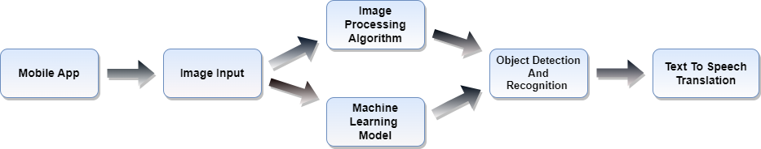
METHODOLOGY SYSTEM DIAGRAM
IT20254520 | Bhagya H.D.M. | TMP-23-198
30 March, 2023

Slide 48
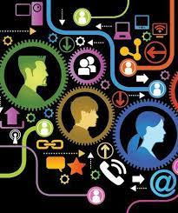
TECHNOLOGIES & TECHNIQUES
Technologies
Techniques
Agile software development techniques can allow for more flexible and iterative development of the app.
User-centered design techniques can help to ensure that the app is designed with the needs of visually impaired users in mind.
The app should be designed to be accessible for users with different levels of visual impairment
Android Studio
Flutter
Firebase
TensorFlow
Amazon Rekognition
Flutter Vision
IT20254520 | Bhagya H.D.M. | TMP-23-198
30 March, 2023

Slide 49

REQUIREMENTS
Software Requirement
Mobile Operating System: The application should be compatible with Android operating systems.
Image detection Engine: The application should use a reliable and high-quality image detection engines
Personal Requirement
Sinhala Language Support: The application should support the Sinhala language and images should cover to the Sinhala characters.
IT20254520 | Bhagya H.D.M. | TMP-23-198
30 March, 2023

Slide 50
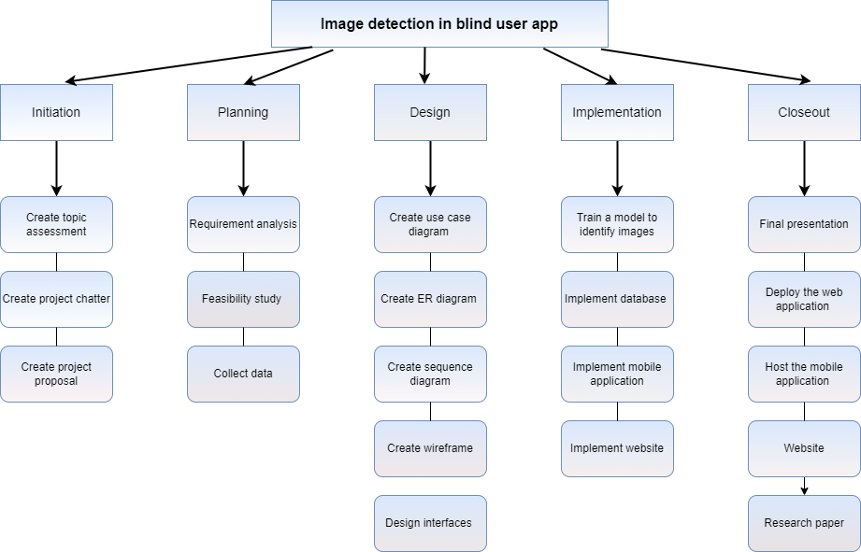
WORK BREAKDOWN CHART
IT20254520 | Bhagya H.D.M. | TMP-23-198
30 March, 2023

Slide 51
REFERENCES
https://www.computer.org/csdl/proceedings-article/cvpr/2015/07298935/12OmNwCJORd
https://ieeexplore.ieee.org/abstract/document/9182201
https://ieeexplore.ieee.org/abstract/document/8371005
https://www.levelaccess.com/blog/understanding-assistive-technology-how-does-a-blind-person-use-the-internet/#:~:text=A%20braille%20display%20is%20a,read%20text%20using%20their%20fingers.
https://nanonets.com/image-recognition
IT20254520 | Bhagya H.D.M. | TMP-23-198
30 March, 2023

Slide 52
Jayathunga T.M.
IT20146238
INFORMATION TECHNOLOGY
IT20146238 | Jayathunga T.M. | TMP-23-198
30 March, 2023

Slide 53
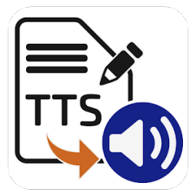
INTRODUCTION
Text-to-Speech (TTS) Synthersizer
IT20146238 | Jayathunga T.M. | TMP-23-198
30 March, 2023

Slide 54
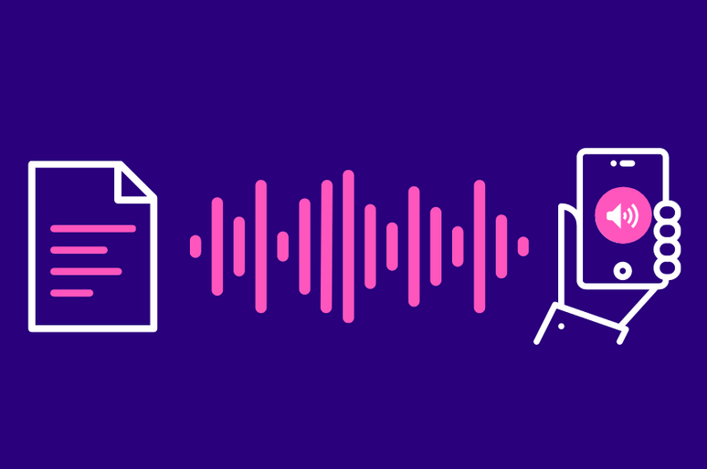
BACKGROUND
TTS stands for Text-To-Speech, which is a technology that converts written text into spoken words. It's a useful tool for visually impaired people as well as others who prefer to listen to content instead of reading it.
The main purpose of using Text to speech (TTS) technology is to give a blind person the ability to access the written text of a Sinhala book. This allows them to easily listen to the valuable content of Sinhala books.
TTS technology allows the written text in a Sinhala book to be read out loud in a natural-sounding voice, which makes it easier for visually impaired people to understand the content.
IT20146238 | Jayathunga T.M. | TMP-23-198
30 March, 2023

Slide 55


RESEARCH GAP
Application Reference | Highly accurate Sinhala TTS conversion system | Real time OCR text send to TTS synthesizer | Adjust the book reading Speed | Support for Sinhala Language | Mobile Application
Research A
Research B
Research C
Research D
Proposed System
IT20146238 | Jayathunga T.M. | TMP-23-198
30 March, 2023

Slide 56

RESEARCH QUESTION
How effective is a mobile-based Sinhala book reader with a text-to-speech function in improving reading accessibility for visually impaired individuals in Sri Lanka, and what factors contribute to its effectiveness?
What are the challenges and opportunities in designing and developing a mobile-based Sinhala book reader with a text-to-speech function that meets the needs of visually impaired individuals in Sri Lanka?
How does the use of a mobile-based Sinhala book reader with a text-to-speech function affect the reading experience and satisfaction of visually impaired individuals in Sri Lanka, and how does it compare to other reading aids and tools currently available?
IT20146238 | Jayathunga T.M. | TMP-23-198
30 March, 2023

Slide 57

RESEARCH PROBLEM
How to develop an accurate Sinhala text-to-speech conversion system that can handle the nuances of the Sinhala language?
How to design a user-friendly interface for visually impaired individuals to access and interact with the mobile-based book reader?
How to evaluate the effectiveness of the mobile-based Sinhala book reader in enhancing the reading experience of visually impaired individuals?
IT20146238 | Jayathunga T.M. | TMP-23-198
30 March, 2023

Slide 58
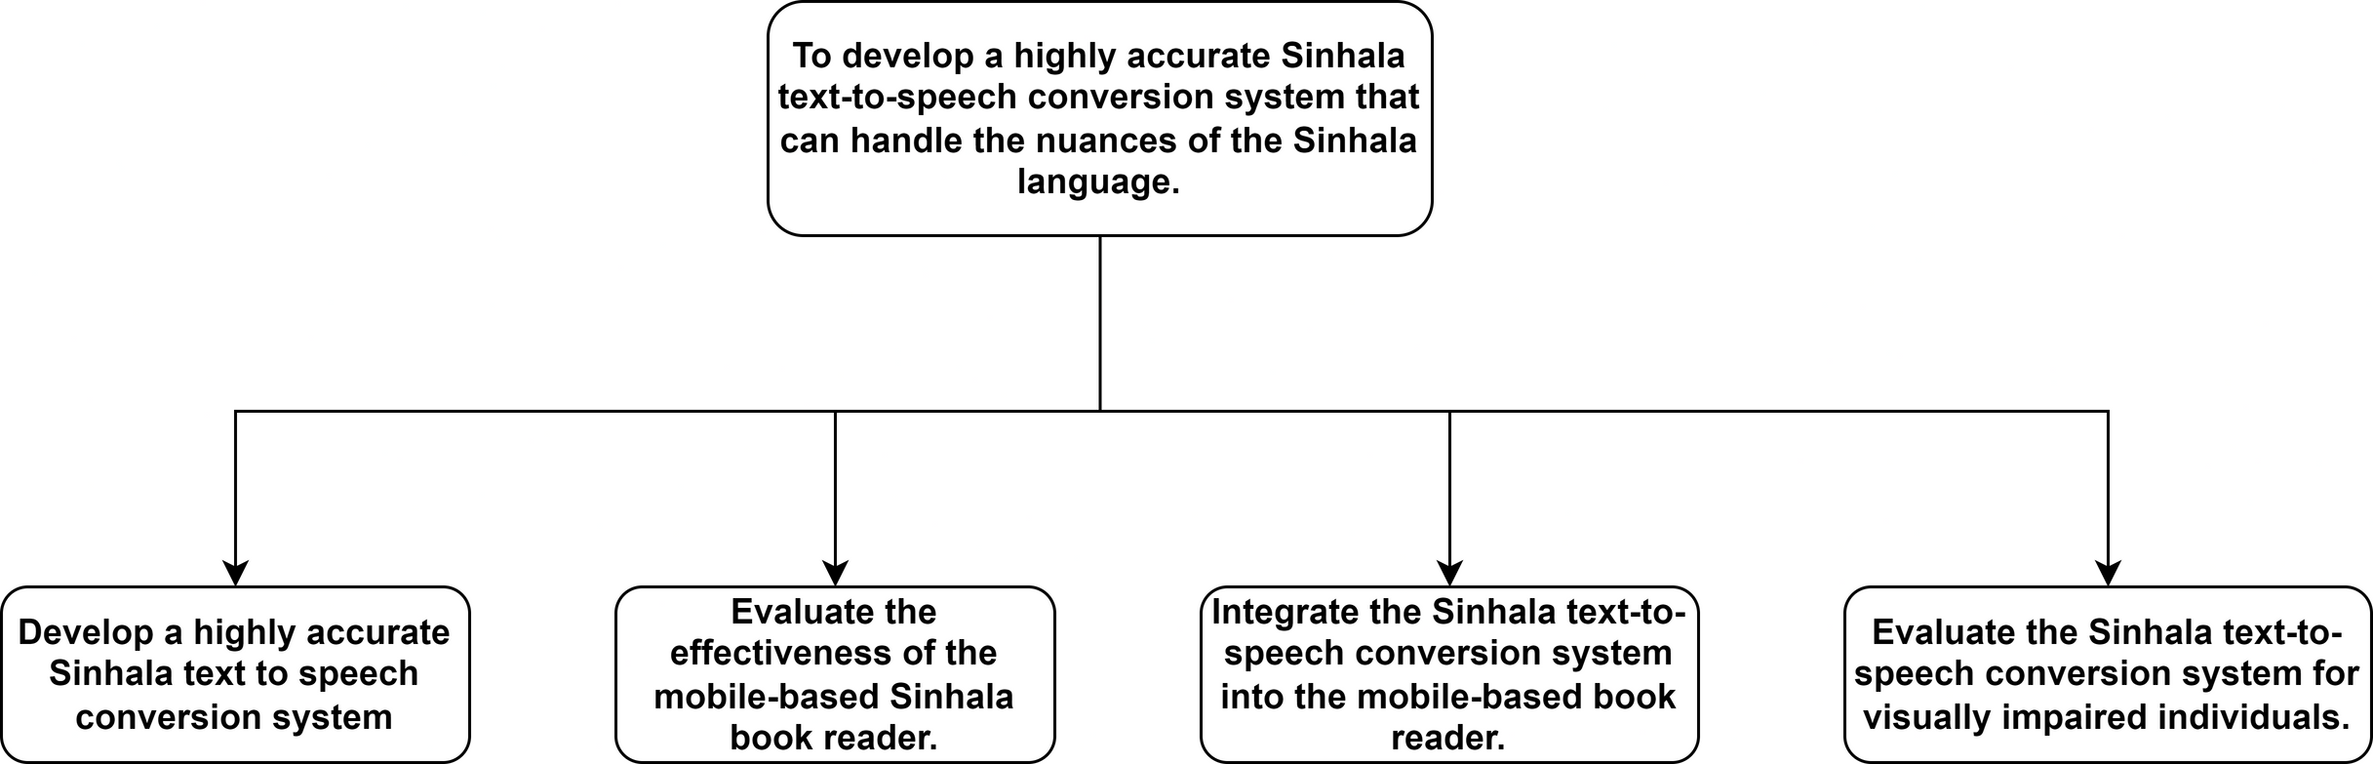
Objectives
IT20146238 | Jayathunga T.M. | TMP-23-198
30 March, 2023

Slide 59
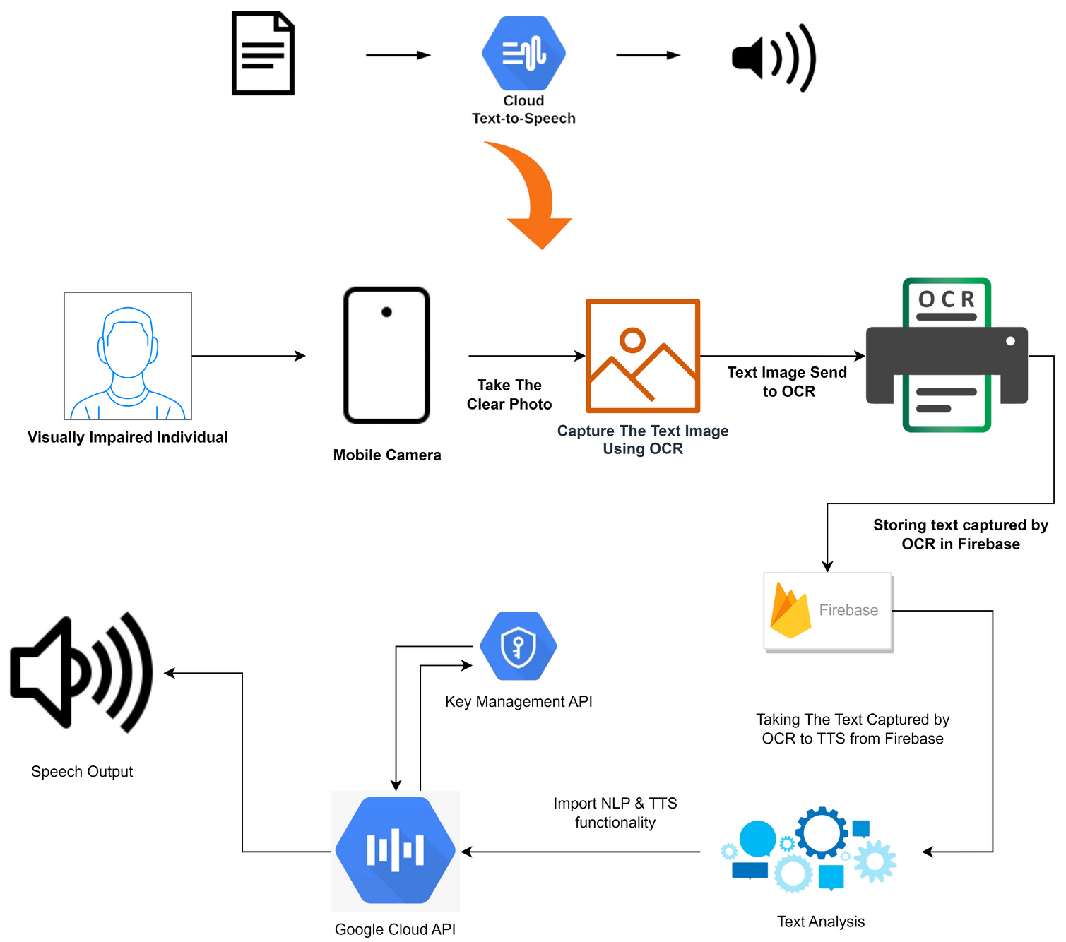
METHODOLOGY SYSTEM DIAGRAM
IT20146238 | Jayathunga T.M. | TMP-23-198
30 March, 2023

Slide 60

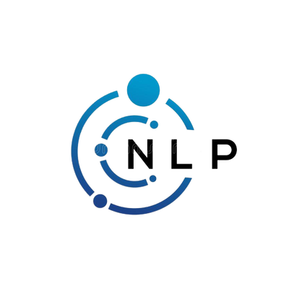
TOOLS & TECHNOLOGIES
Android Studio
Flutter
Firebase
Google API
Flutter_tts
TTS Engine
Amazon Polly
TensorFlow
Natural Language Processing
IT20146238 | Jayathunga T.M. | TMP-23-198
30 March, 2023

Slide 61

TECHNIQUES
User-centered design techniques can help to ensure that the app is designed with the needs of visually impaired users in mind.
Agile software development techniques can allow for more flexible and iterative development of the app.
Usability testing techniques like user testing can help to identify and address usability issues in the app.
Continuous integration and deployment techniques can allow for more efficient and frequent updates to the app.
Localization techniques can ensure that the app is properly adapted to the Sinhala language and culture.
IT20146238 | Jayathunga T.M. | TMP-23-198
30 March, 2023

Slide 62

FUNCTIONAL & NON-FUNCTIONAL REQUIREMENT
Functional
Non-Functional
The mobile book reader must have a high-quality text-to-speech (TTS) engine capable of accurately reading Sinhala text out loud.
The TTS function must have adjustable speed settings so that visually impaired individual can adjust the reading speed according to their preferences.
The TTS function should have a pause and resume feature so that the user can stop and start the reading at any time.
Performance: Responsive and seamless TTS conversion and navigation.
Accessibility: The application should be accessible to visually impaired individuals and conform to accessibility guidelines.
Reliability: The application should be reliable and provide consistent TTS conversion
.
Security: The application should be secure to protect user information and reading history.
IT20146238 | Jayathunga T.M. | TMP-23-198
30 March, 2023

Slide 63
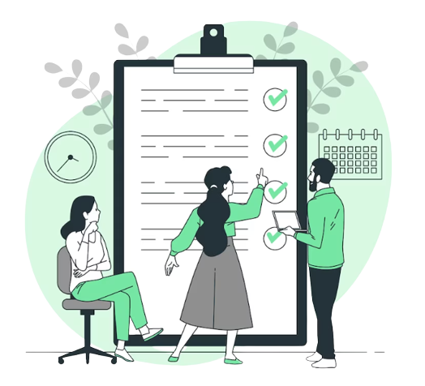
SOFTWARE & PERSONAL REQUIREMENTS
Software Requirement
Mobile Operating System: The application should be compatible with Android operating systems.
TTS Engine: The application should use a reliable and high-quality TTS engine like Google Text-to-Speech.
Personal Requirements
Sinhala Language Support: The application should support the Sinhala language and have accurate TTS conversion for Sinhala text.
IT20146238 | Jayathunga T.M. | TMP-23-198
30 March, 2023

Slide 64
WORK BREAKDOWN STRUCTURE
IT20146238 | Jayathunga T.M. | TMP-23-198
30 March, 2023

Slide 65
REFERENCE
[1] K. Sodimana et al., “A Step-by-Step Process for Building TTS Voices Using Open Source Data and Frameworks for Bangla, Javanese, Khmer, Nepali, Sinhala, and Sundanese,” 6th Work. Spok. Lang. Technol. Under-Resourced Lang. SLTU 2018, no. August, pp. 66–70, 2018, doi: 10.21437/SLTU.2018-14.
[2] A. Mishangi, “Android based sinhala document reader for visually impaired people,” 2021.
[3] A. A. Kumar, B. Senthilvasudevan, and H. U. Farhan, “Translation of Multilingual Text into Speech for Visually Impaired Person,” 7th Int. Conf. Commun. Electron. Syst. ICCES 2022 - Proc., no. Icces, pp. 60–64, 2022, doi: 10.1109/ICCES54183.2022.9835819.
[4] L. Nanayakkara, C. Liyanage, P. T. Viswakula, T. Nadungodage, R. Pushpananda, and R. Weerasinghe, “A Human Quality Text to Speech System for Sinhala,” 6th Work. Spok. Lang. Technol. Under-Resourced Lang. SLTU 2018, no. August, pp. 157–161, 2018, doi: 10.21437/SLTU.2018-33.
[5] R. Weerasinghe, A. Wasala, D. Herath, and V. Welgama, “NLP applications of Sinhala: TTS & OCR,” IJCNLP 2008 - 3rd Int. Jt. Conf. Nat. Lang. Process. Proc. Conf., vol. 2, pp. 963–966, 2008.
IT20146238 | Jayathunga T.M. | TMP-23-198
30 March, 2023

Slide 66
REFERENCE
[6] A. Walczak and A. Szarkowska, “Text-to-speech audio description for visually impaired children,” no. March, pp. 24–25, 2011.
[7] K. Wasala, A., Weerasinghe, R., Gamage, “A Sinhala Text-to-Speech System,” 2007.
[8] H. M. Nasir, N. M. A. Brahin, M. M. M. Aminuddin, M. S. Mispan, and M. F. Zulkifli, “Android based application for visually impaired using deep learning approach,” IAES Int. J. Artif. Intell., vol. 10, no. 4, pp. 879–888, 2021, doi: 10.11591/ijai.v10.i4.pp879-888.
[9] G. V. S. Murthy et al., “The Sri Lanka National Blindness, Visual Impairment and Disability Survey: rationale, objectives and detailed methodology,” Ceylon Med. J., vol. 63, no. 5, p. 3, 2018, doi: 10.4038/cmj.v63i5.8735.
[10] WHO, World report on vision, vol. 214, no. 14. 2019. [Online]. Available: https://www.who.int/publications-detail/world-report-on-vision

Slide 67

SUPPORTIVE INFORMATION BUDGET
Development Cost
Server & Hosting Cost
Marketing Budget
Purchasing necessary Softwares
Maintenance Budget
Legal & Administrative Expenses
IT20146238 | Jayathunga T.M. | TMP-23-198
30 March, 2023

Slide 68
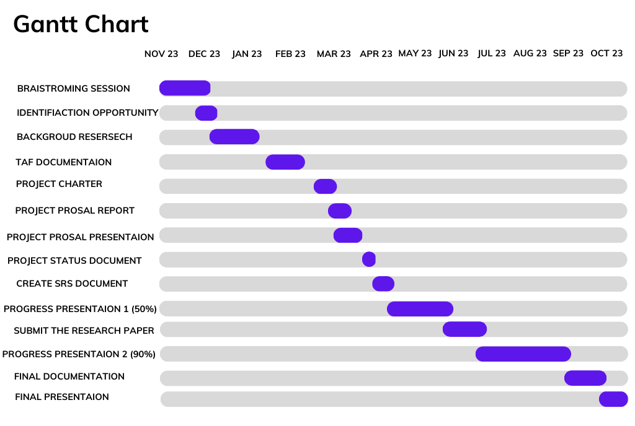
GANTT CHART
IT20146238 | Jayathunga T.M. | TMP-23-198
30 March, 2023

Slide 69
Thank You

